Slide 1

GROCERY STORE MANAGEMENT
Presented by: SAMA CHETANA
Batch No. : 536

Slide 2
ABOUT ME
Background:
B.Tech – Artificial Intelligence & Data Science
Shadan Women’s College of Engineering & Technology
2021–2025
Why Data Science?
I chose Data Science because I like understanding the ‘why’ behind things. Instead of just looking at information, I wanted to learn how to find patterns, make sense of data, and use technology to solve problems. What attracted me most was that Data Science brings together programming, analysis, AI, and problem-solving — areas I genuinely enjoy exploring.
Professional Profiles
LinkedIn : linkedin.com/in/sama-chetana-71142031b
GitHub: https://github.com/chetanareddy04

Slide 3
AGENDA
Business Problem
Problem Statement
Introduction
Data Description
Queries & Outputs
Insights
Recommendations
Conclusion

Slide 4
BUSINESS PROBLEM
Grocery stores generate data across products, suppliers, customers, employees, and orders. Without a structured system, this data becomes difficult to manage and analyze effectively.
Key Challenges
Managing product, supplier, and category information
Tracking orders and sales efficiently
Understanding customer purchasing patterns
Identifying top-performing products and categories
Analyzing revenue and overall business performance
Generating quick, reliable insights for decision-making

Slide 5
PROBLEM STATEMENT
To address these challenges, we developed a centralized Grocery Store Management System using SQL to organize and manage information related to products, suppliers, customers, employees, and orders. We then use SQL queries to analyze the data and generate meaningful business insights for better decision-making.

Slide 6
INTRODUCTION
The Grocery Store Management System is a database management project developed using MySQL to efficiently organize and manage the day-to-day data of a grocery store.
The project brings together information about products, categories, suppliers, customers, employees, and orders into a structured relational database.
Using SQL queries, joins, aggregations, subqueries, and other SQL operations, the system allows us to retrieve relevant information, analyze store data, and generate useful business insights.

Slide 7
DATA DESCRIPTION
Table Name | Column Name | Data Type
Suppliers | sup_id | TINYINT
Suppliers | sup_name | VARCHAR(255)
Suppliers | address | TEXT
Categories | cat_id | TINYINT
Categories | cat_name | VARCHAR(255)
Store Employees | emp_id | TINYINT
Store Employees | emp_name | VARCHAR(255)
Store Employees | hire_date | VARCHAR(255)
Customers | cust_id | SMALLINT
Customers | cust_name | VARCHAR(255)
Customers | address | TEXT
Products | prod_id | TINYINT
Products | prod_name | VARCHAR(255)

Slide 8
Table Name | Column Name | Data Type
Products | sup_id | TINYINT
Products | cat_id | TINYINT
Products | price | DECIMAL(10,2)
Orders | ord_id | SMALLINT
Orders | cust_id | SMALLINT
Orders | emp_id | TINYINT
Orders | order_date | VARCHAR(255)
Order Details | ord_detID | SMALLINT
Order Details | ord_id | SMALLINT
Order Details | prod_id | TINYINT
Order Details | quantity | TINYINT
Order Details | each_price | DECIMAL(10,2)
Order Details | total_price | DECIMAL(10,2)

Slide 9
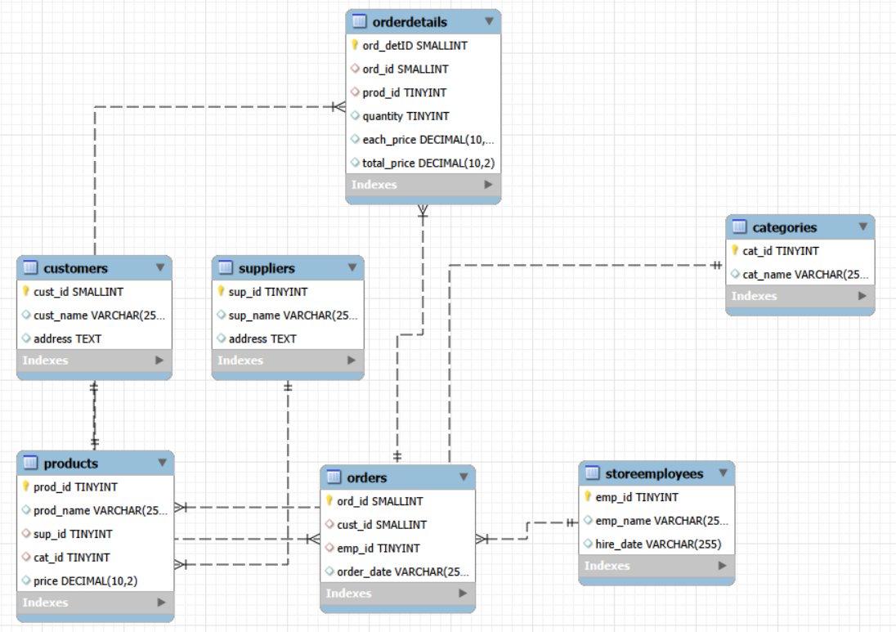
E-R DIAGRAM

Slide 10
CARDINALITY
Parent Name | Child Name | Cardinality
Suppliers | Products | 1:N
Categories | Products | 1:N
Customers | Orders | 1:N
Store Employees | Orders | 1:N
Orders | Order Details | 1:N
Products | Order Details | 1:N
Orders | Products | N:N

Slide 11

QUERIES & OUTPUTS
1.Which customers have placed the highest number of orders?
WITH customer_ranking AS(
SELECT cust.cust_id, cust.cust_name,
COUNT(ord.ord_id) as no_of_orders,
RANK() OVER(ORDER BY
COUNT(ord.ord_id)DESC) AS orders_rank
FROM customers as cust
JOIN orders as ord
ON cust.cust_id=ord.cust_id
GROUP BY cust.cust_id,cust.cust_name)
SELECT cust_id,cust_name,no_of_orders,orders_rank
FROM customer_ranking
WHERE orders_rank=1;

Slide 12
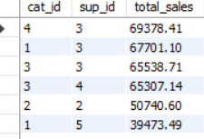
2.How do product sales vary by category and supplier?
CREATE VIEW category_supplier_sales AS
SELECT
prod.cat_id,
prod.sup_id,
SUM(ord_det.total_price) AS total_sales
FROM products AS prod
JOIN orderdetails AS ord_det
ON prod.prod_id = ord_det.prod_id
GROUP BY prod.cat_id, prod.sup_id;
SELECT *FROM category_supplier_sales
ORDER BY total_sales DESC;

Slide 13

3. On which dates were the most orders placed?
SELECT
order_date,
total_orders
FROM (
SELECT
order_date,
COUNT(ord_id) AS total_orders,
MAX(COUNT(ord_id)) OVER ()
AS highest_orders
FROM orders
GROUP BY order_date)
AS daily_orders
WHERE total_orders = highest_orders;

Slide 14

4. How do order patterns vary across weekdays and weekends?
SELECT
CASE
WHEN DAYOFWEEK(STR_TO_DATE(order_date,
'%m/%d/%Y’)) IN (1, 7)
THEN 'Weekend'
ELSE 'Weekday'
END AS day_type,
COUNT(DISTINCT ord_id) AS total_orders
FROM orders
GROUP BY day_type;

Slide 15

5.Which supplier provides the most products?
SELECT
sup_id,
sup_name,
total_products
FROM (
SELECT
s.sup_id,
s.sup_name,
COUNT(p.prod_id) AS total_products,
ROW_NUMBER() OVER (
ORDER BY COUNT(p.prod_id) DESC) AS supplier_rank
FROM suppliers AS s
JOIN products AS p
ON s.sup_id = p.sup_id
GROUP BY s.sup_id, s.sup_name)
AS supplier_ranking
WHERE supplier_rank = 1;

Slide 16
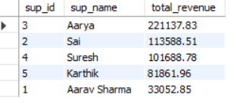
6.Which suppliers contribute the most to total product sales
(by revenue)?
DELIMITER //
CREATE PROCEDURE GetSupplierRevenue()
BEGIN
SELECT s.sup_id,s.sup_name,SUM(od.total_price) AS
total_revenue
FROM suppliers AS s
JOIN products AS p
ON s.sup_id = p.sup_id
JOIN orderdetails AS od
ON p.prod_id = od.prod_id
GROUP BY s.sup_id, s.sup_name
ORDER BY total_revenue DESC;
END //
DELIMITER ;
CALL GetSupplierRevenue();

Slide 17
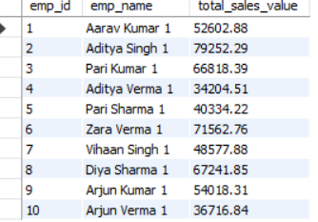
7. What is the total sales value processed by each employee?
SELECT DISTINCT
se.emp_id,
se.emp_name,
SUM(od.total_price) OVER (PARTITION BY
se.emp_id) AS total_sales_value
FROM storeemployees AS se
JOIN orders AS o
ON se.emp_id = o.emp_id
JOIN orderdetails AS od
ON o.ord_id = od.ord_id;

Slide 18
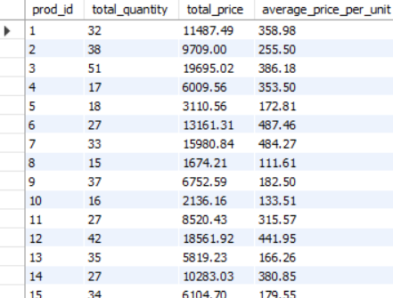
8. What is the relationship between quantity ordered and total price?
SELECT
prod_id,
SUM(quantity) AS total_quantity,
SUM(total_price) AS total_price,
CASE
WHEN SUM(quantity) > 0
THEN ROUND(SUM(total_price) /SUM(quantity),2)
ELSE 0
END AS average_price_per_unit
FROM orderdetails
GROUP BY prod_id;

Slide 19
INSIGHTS
. Top Products: Identified the products generating the highest revenue.
Best Categories: Determined which product categories contribute most to sales.
Customer Spending: Identified customers with the highest purchase amounts.
Order Patterns: Observed trends in order volume and purchasing activity.
Supplier Contribution: Identified suppliers providing the highest number of products.
Business Performance: Gained an overall view of sales, customers, products, and supplier performance to support better decision-making.

Slide 20
RECOMMENDATIONS
Maintain sufficient stock of high-demand products to prevent stock-outs and lost sales.
Identify and improve low-performing products through discounts, promotions, or better product placement.
Focus on high-revenue product categories to maximize overall store revenue.
Strengthen supplier management by working with reliable suppliers and monitoring supplier performance.
Reward loyal customers with discounts, loyalty programs, and personalized offers.
Use sales trends to plan inventory and make better purchasing decisions.
Monitor revenue and order patterns regularly to support data-driven business decisions.

Slide 21
CONCLUSION
The Grocery Store Management project successfully demonstrates how SQL can be used to efficiently manage and analyze grocery store data. By integrating information about suppliers, categories, products, employees, customers, and orders, the database provides a structured view of store operations. The analysis helped identify sales performance, revenue patterns, top-selling products, customer purchasing behavior, and other key business insights. Overall, the project shows how SQL-based data management and analysis can support better decision-making, improve operational efficiency, and help the store understand its business performance.

Slide 22
Q & A
Thank you for your time and attention.
I welcome your questions and feedback.

Slide 23

THANK YOU

